Slide 1
Energy efficient UDN design using reinforcement learning
DGIST
BongSang Kim
JaeHyun Lee
19/July/2019
UGRP Meeting

Slide 2
Progress
Design Env code – done
Design RL code – MCTS
Remodel based on sample library
Most of MCTS libraries are for sequential game
→ We decided to mcts.py module instead of using MCTS library
Make three module(2 module has done)
UDNEnv.py: environment code
ppp.py: BSposition.csv(information of BS position) create
mcts: RL code.py
Each module runs independently
Having problems running UDNEnv onto MCTS

Slide 3
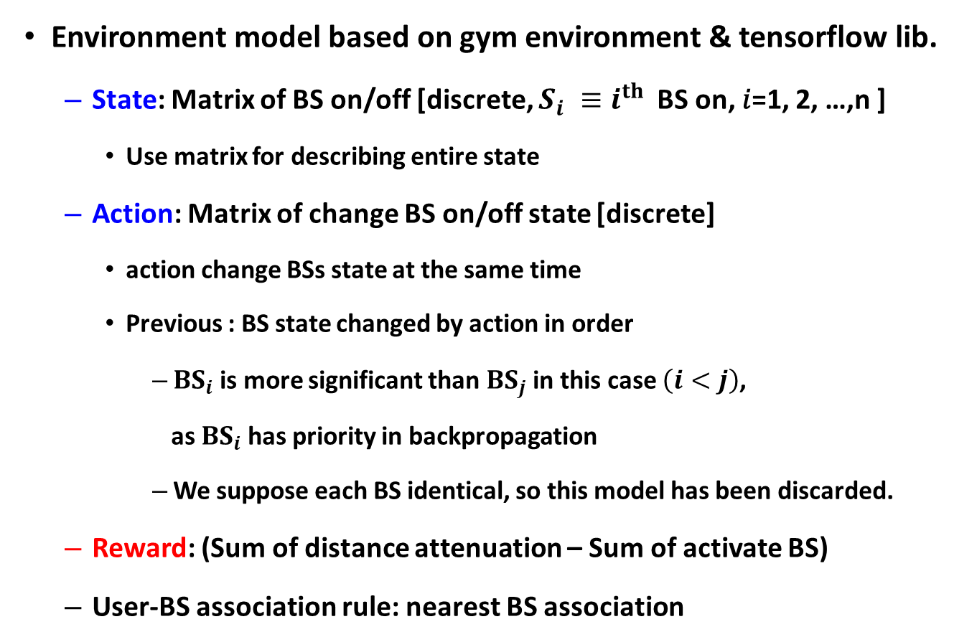
Environment model design
Environment model based on gym environment & tensorflow lib.
State: Matrix of BS on/off [discrete, $S_{i} ≡i^{th}$BS on, 𝑖=1, 2, …,n ]
Use matrix for describing entire state
Action: Matrix of change BS on/off state [discrete]
action change BSs state at the same time
Previous : BS state changed by action in order
${BS}_{i}$is more significant than ${BS}_{j}$ in this case $\left(i<j\right)$,
as ${BS}_{i}$has priority in backpropagation
We suppose each BS identical, so this model has been discarded.
Reward: (Sum of distance attenuation – Sum of activate BS)
User-BS association rule: nearest BS association

Slide 4
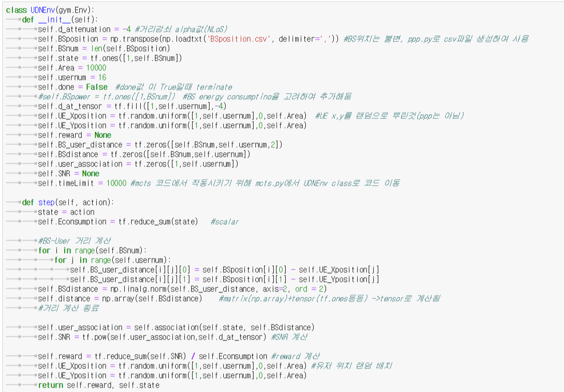
Environment model design

Slide 5
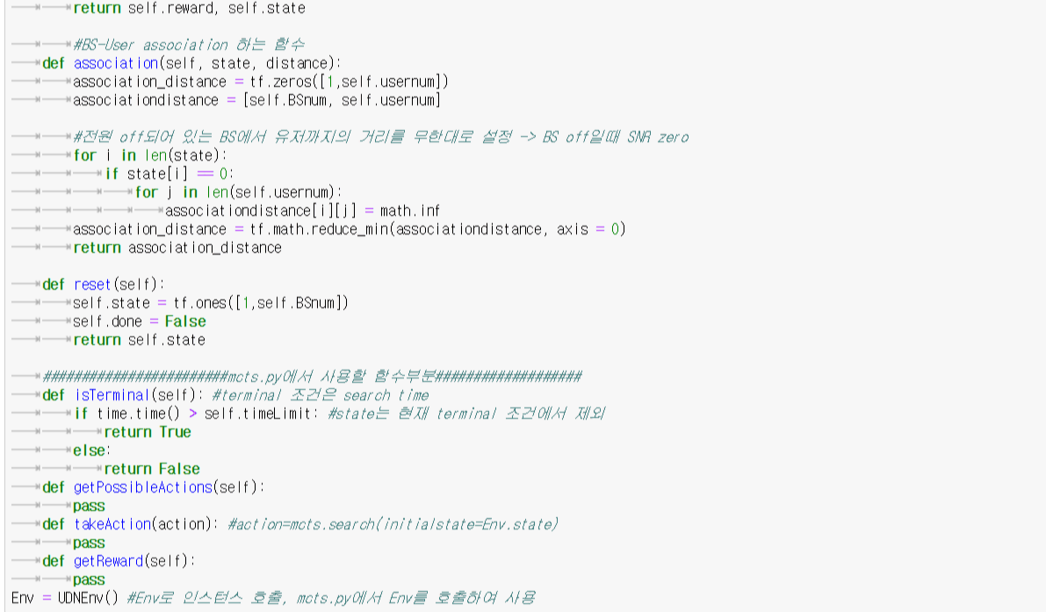
Environment model design

Slide 6
RL model design
Use Monte Carlo Tree Search
Utilize MCTS library on GitHub
Env model doesn’t run on MCTS library.
the library needs state object involving algorithm functions
As we are going to make another env instance later, designing env object instead of sole state object is considered reasonable
Remodeling MCTS library into MCTS module so that env code would run on mcts.py

Slide 7
RL model design
def isTerminal(): #return Boolean value
if search time > threshold:
return True
else:
return False
def getPossibleActions(env.state):
return iterable list of possible actions from specific env.state
- in progress
def takeAction(action):
return the state which results from taking action
- in progress
def getReward(env.state):
return the reward of specific state
-in progress

Slide 8
RL model design
class mcts():
def __init__():
def search():
def selectNode():
def backpropagate():
…
MCTS algorithm is already implemented in class mcts()
Several variables needs editing to run Env code in mcts.py

Slide 9
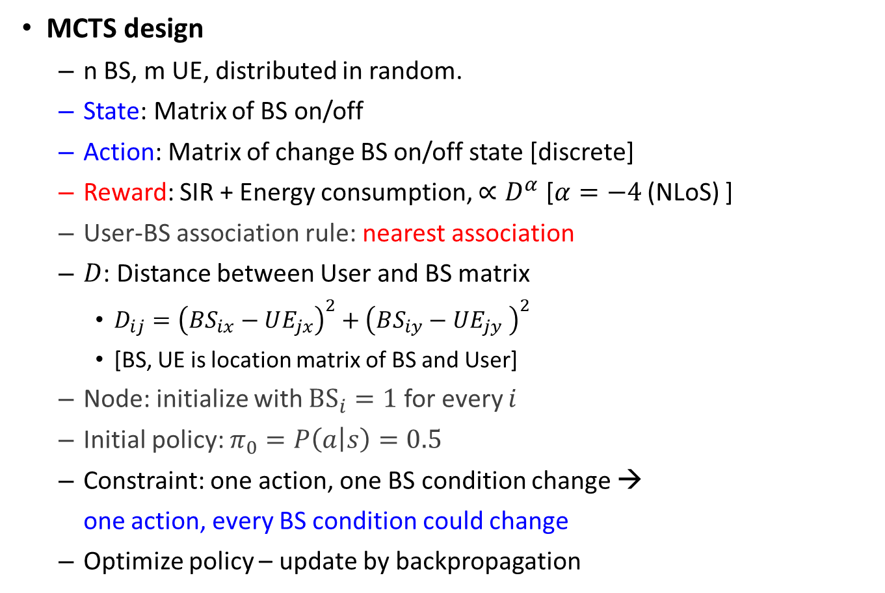
Future Plan(next week) at 7/5
MCTS design
n BS, m UE, distributed in random.
State: Matrix of BS on/off
Action: Matrix of change BS on/off state [discrete]
Reward: SIR + Energy consumption, $∝D^{α}$ [$α=−4$ (NLoS) ]
User-BS association rule: nearest association
$D$: Distance between User and BS matrix
$D_{ij}={\left(BS_{ix}−UE_{jx}\right)}^{2}+{\left(BS_{iy}−UE_{jy} \right)}^{2}$
[BS, UE is location matrix of BS and User]
Node: initialize with ${BS}_{i}=1$ for every $i$
Initial policy: $π_{0}=P\left(a | s\right)=0.5$
Constraint: one action, one BS condition change →
one action, every BS condition could change
Optimize policy – update by backpropagation
done
In progress – MCTS module

Slide 10
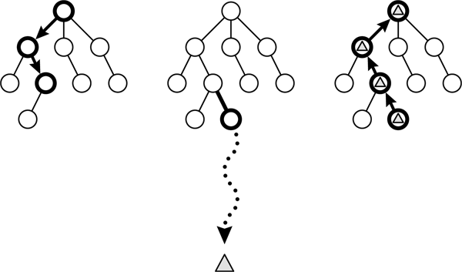
Future Plan(next week) at 7/5
In progress – MCTS module

Slide 11
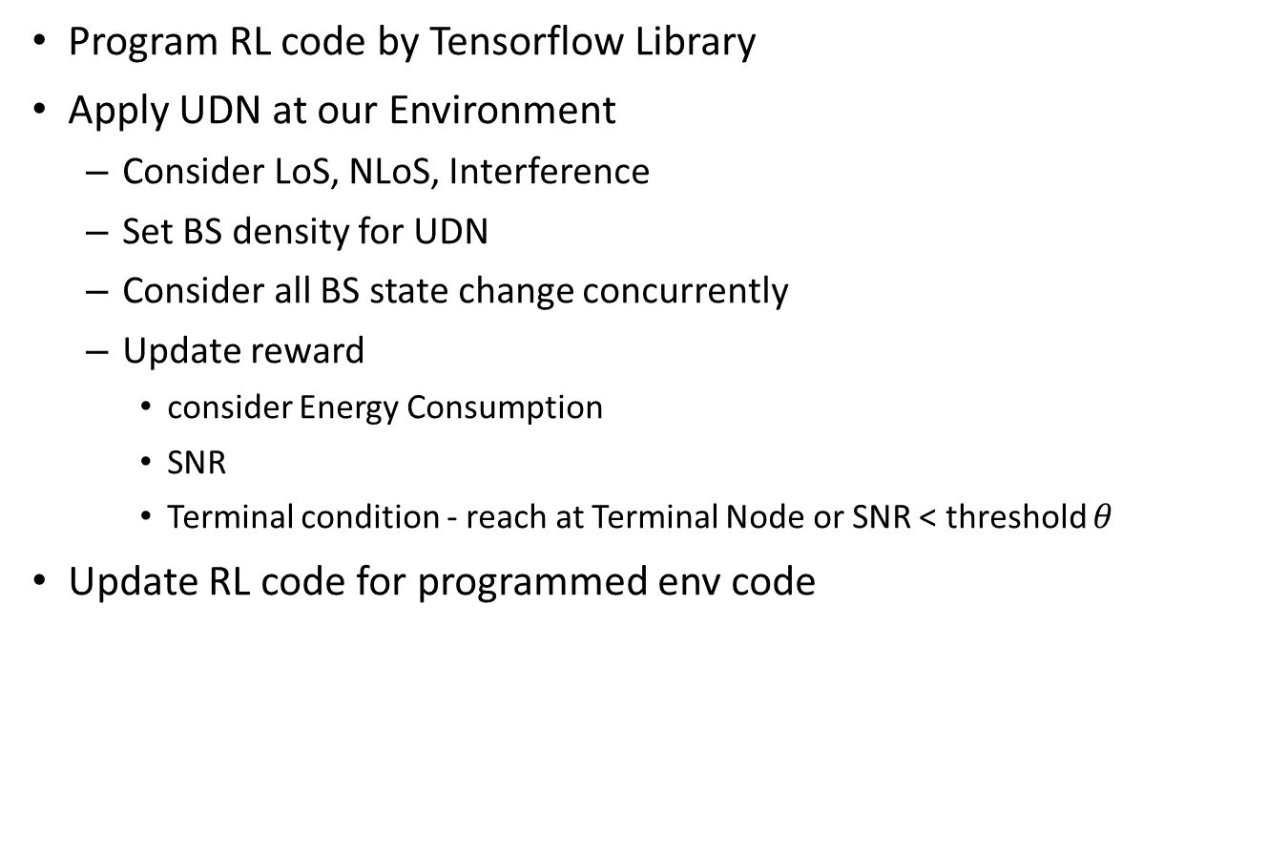
Future plan(one month) at 7/5
Program RL code by Tensorflow Library
Apply UDN at our Environment
Consider LoS, NLoS, Interference
Set BS density for UDN
Consider all BS state change concurrently
Update reward
consider Energy Consumption
SNR
Terminal condition - reach at Terminal Node or SNR < threshold $θ$
Update RL code for programmed env code

Slide 12
Thank you
Any Questions?

